Slide 1

Creation and Generation Copyright Standards
26 July 2024
Associate Professor Danny FRIEDMANN
Notes:
Thank you very much for this opportunity to share my research with you on AI and copyright law

Slide 2
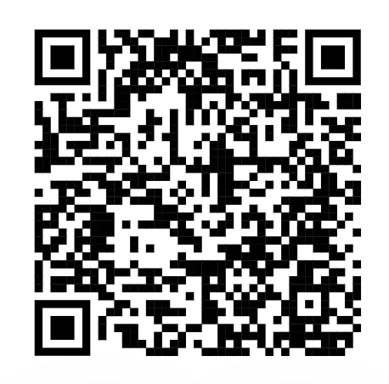
Danny Friedmann, Creation and Generation Copyright Standards
New York University Journal of Intellectual Property and Entertainment Law, forthcoming 2024, available at SSRN: https://ssrn.com/abstract=4770924
Notes:
I observed that both the U.S. Copyright Office and the Beijing Internet Court use both very high, unattainable high, standards to register an AI-generated image under copyright, but for traditional works a much lower standard is used. Even though these two institutions have different outcomes; in the U.S., the registration of four different AI-generated images have been rejected, and China, the registration of one AI-generated image has been accepted under copyright, both use the same high, what I call “platonic” standards.

Slide 3
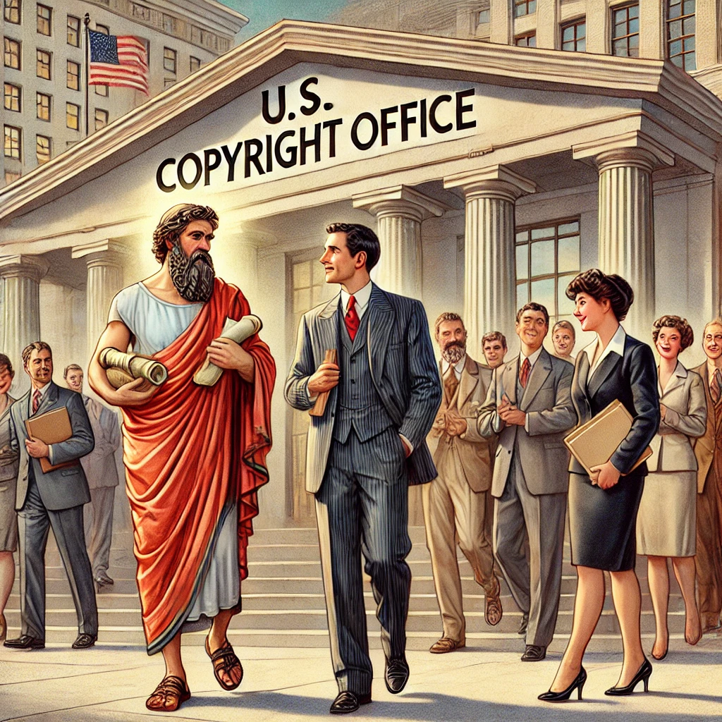
Human intervention
Linear mental conception
Full control over the creative process of the work,
inalienable bond between author and work
No instructions of ideas
Notes:
The “platonic” standards of the U.S. Copyright Office are: human intervention, which is reasonable, but also unrealistic standards: linear mental conception of the work; full control over the creative process of the work; an inalienable bond between author and work; and no instructions of ideas.

Slide 4
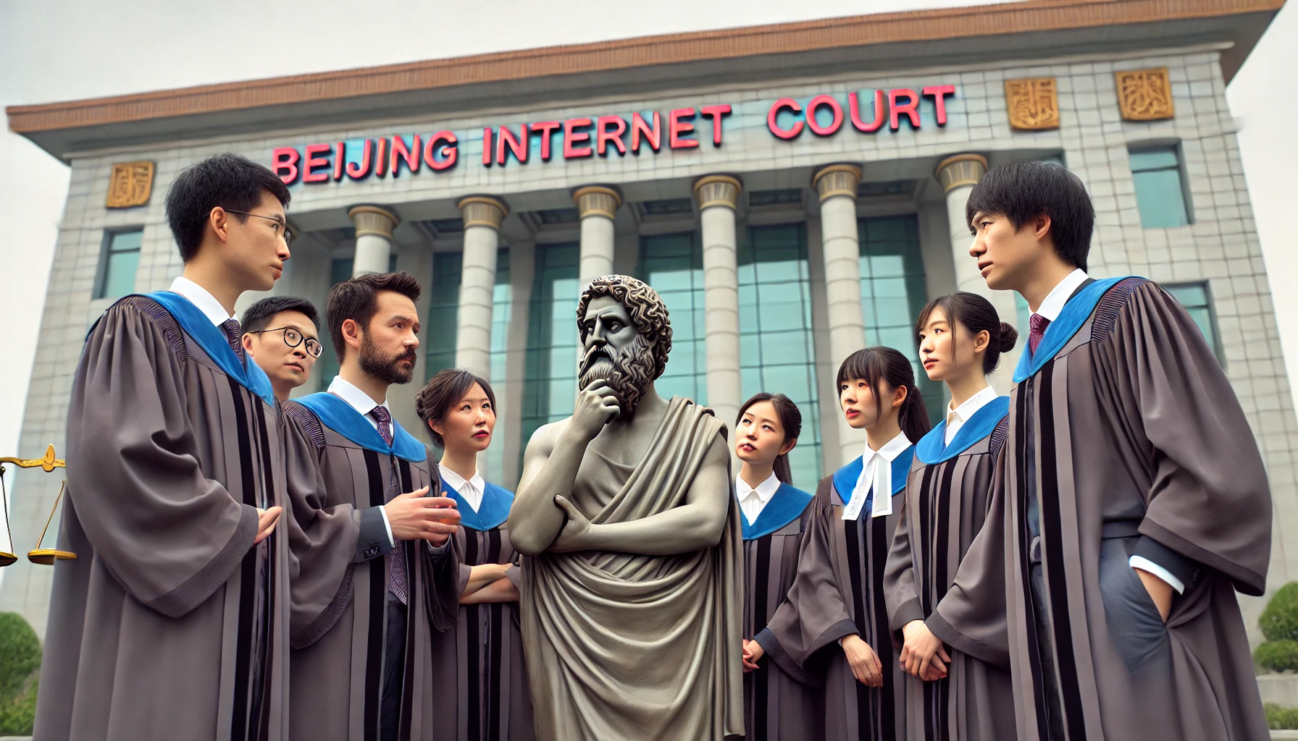
Human intervention
Linear mental conception
Full control over the creative process of the work
inalienable bond between author and work
No instructions of ideas
Notes:
The same high standards can be observed at the Beijing Internet Court case, but with a different outcome.
Let us take a short look at rejections by the U.S.

Slide 5
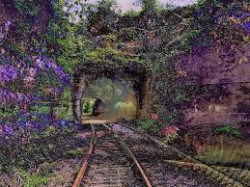
No human-intervention
Notes:
The U.S. Copyright Office refused this AI-generated image called “A Recent Entrance to Paradise,” (Feb. 14, 2022) because it was autonomously generated by an AI developed by Dr. Stephen Thaler, which he called the Creativity Machine.
Thaler appealed against the decision of the U.S. Copyright Office at the U.S. District Court for the District of Columbia, but here the U.S. Copyright Office prevailed (Aug. 18, 2023). The reason: there was no human intervention in the “creation”.

Slide 6
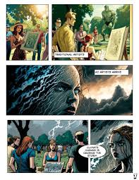
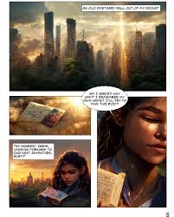
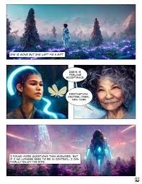
No control over result
Notes:
The U.S. Copyright Office registered Kristina Kashtanova’s graphic novel entitled “Zarya of the Dawn”, (Feb. 21, 2023). On social media Ms Kashtanova made clear she had used Midjourney, a text-to-image gAI to generate the images of the album. Then, the U.S. Copyright Office reconsidered the registration and said that she could register the copyright in the text she wrote, and over the selection, coordination, and arrangement of the work’s written and visual elements, but not in the AI-generated images themselves, because Ms Kashtanova only gave instructions and no expressions.

Slide 7
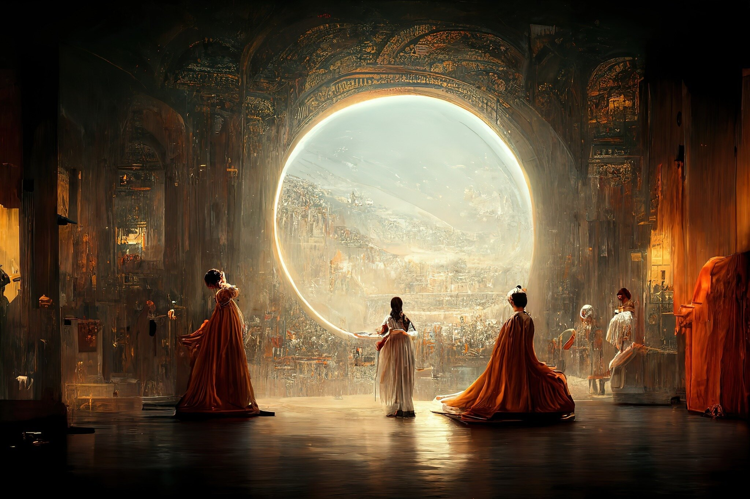
No disclaiming AI-generation
Notes:
Jason Allen won the 2022 Colorado State Fair’s annual fine art competition with this AI-generated image called Théâtre D’opéra Spatial. The U.S. Copyright Office refused to register this image because (Sep. 5, 2023) they found that the image contains more than a de minimis amount of AI-generated content (Midjourney), which must be disclaimed in an application for registration. But Mr Allen refused to disclaim anything, so the image was rejected registration.

Slide 8
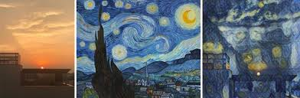
No control over result
Notes:
Ankit Sahni, used an “AI-powered tool,” that can perform “Neural Style Transfer,” which is mixing an image of one image with the style of another. So Mr Sahni used a picture he made (on the left) and mixed it with a picture from Starry Night of Vincent van Gogh (in the middle), the result Mr Sahni called “Suryast,” which means sundown in hindi language. The U.S. Copyright Office held that SURYAST, (Dec. 11, 2023) was not registrable under copyright law, because there was a lack of creative control. The expressive elements of pictorial authorship were not provided by Mr. Sahni.

Slide 9
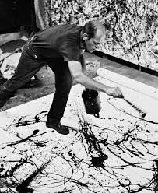
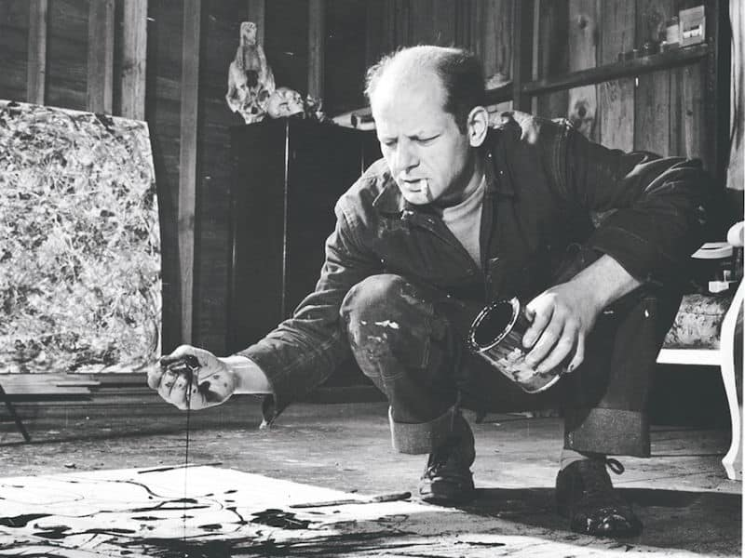
Randomness
Notes:
With traditional works, such as Jackson Pollock’s paintings, lack of control, randomness and serendipity were never issues for the question of registrability of copyright.

Slide 10
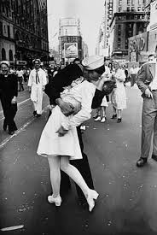
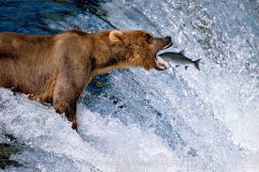
Serendipity
Notes:
With traditional works such as photography serendipity is no problem. Both photographers (Alfred Eisenstaedt, photographing a sailor kissing a woman on Victory over Japan day; and Thomas Mangelsen who photographed the brown bear, catch of the day) happen to be at the right time and at the right place. However, both claim that they prepared for it. It might be like the saying: preparation plus opportunity equals success.

Slide 11
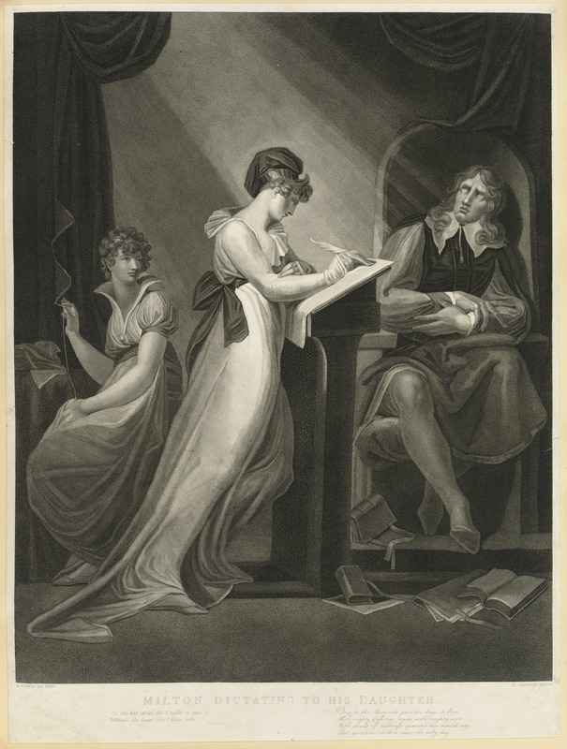
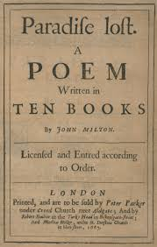
Non-Linearity
Notes:
A normal creative process is not linear, but in fits and starts. Here is the blind John Milton dictating his magnus opus: Paradise Lost, in one go. He might be the exception to create linearly, because he thought about the book all his live.

Slide 12
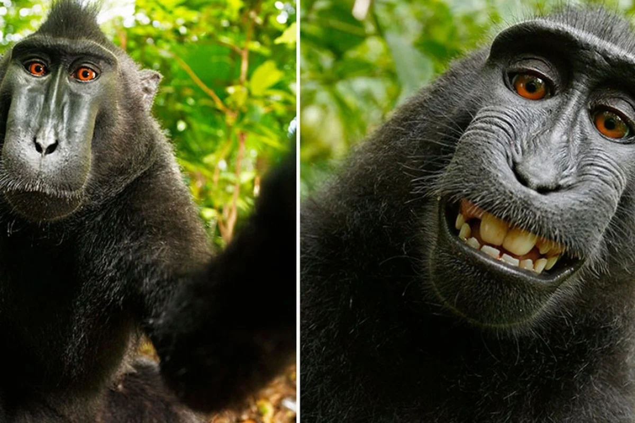
Non-human intervention
Notes:
Professor Balganesh and the late Professor Burk have convincingly argued a more generous interpretation of Naruto v David Slater, is imaginable: if the court would have held that David Slater was the author, because he set the scene, and created the situation were the selfies made by the macaques were expected.

Slide 13
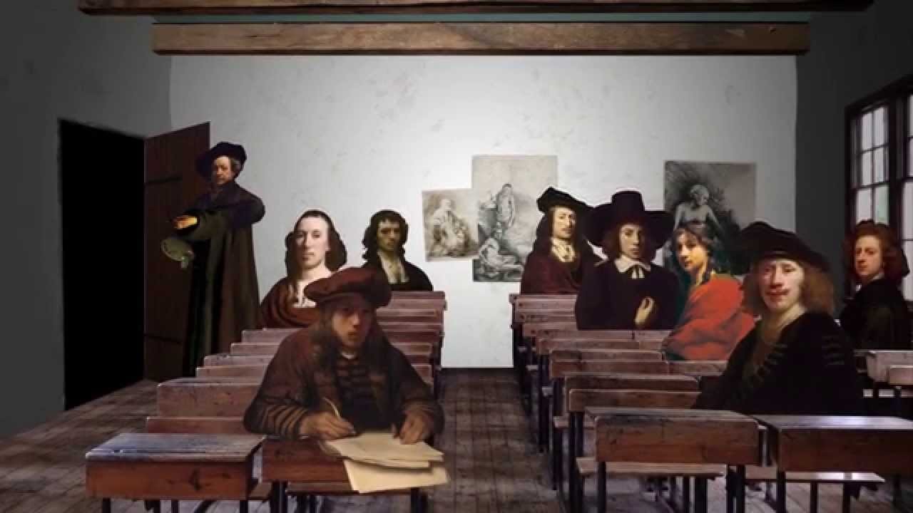
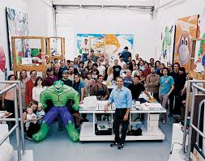
Inalienable bond between author and work
Notes:
In traditional works, there is also not always a direct, inalienable bond between author and work. In the workshop of Rembrandt van Rijn, pupils studied with the master, but even though Rembrandt did not touch the canvas, the basically created the work. Jeff Koons, the American conceptual artist, is not creating anything with his own hands. For this he has employees, and because of the work-made-for-hire doctrine, he can still call himself the author, and copyright holder.

Slide 14
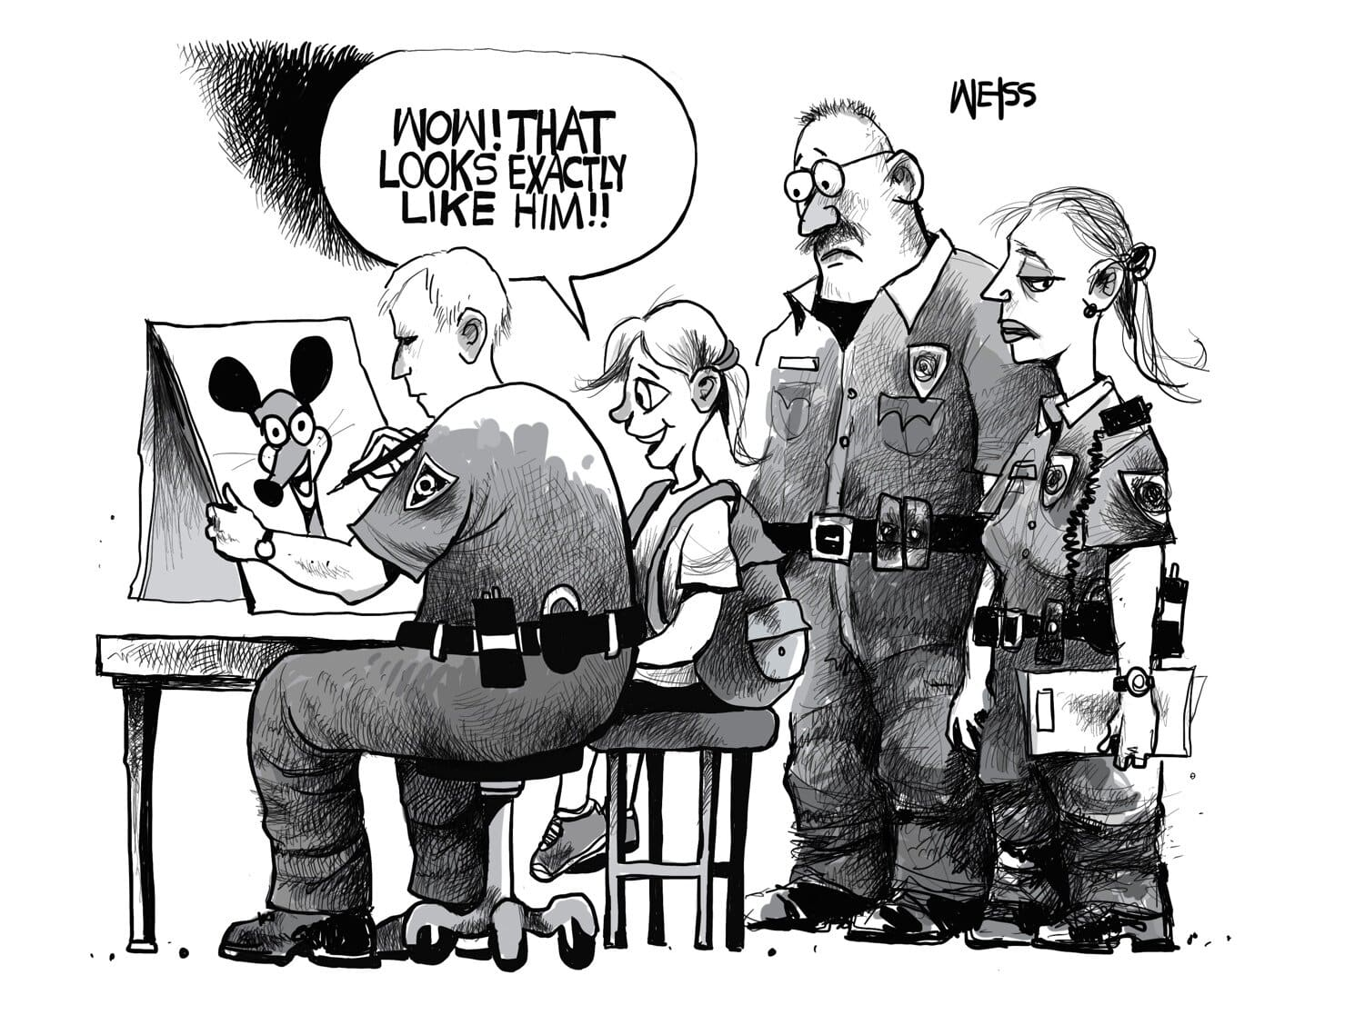

At some moment ideas become expressions
Expression of ideas
Instructions of ideas
Notes:
And if you keep giving ever more fine-grained instructions, there comes a moment when instructions of ideas become expressions of ideas.

Slide 15
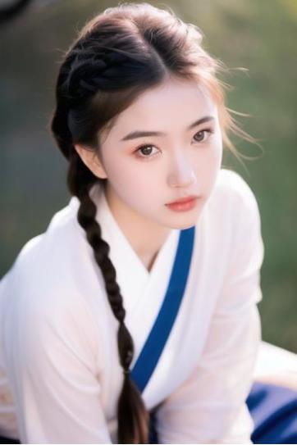
Control over result sufficient
Positive prompts:
“ultra-photorealistic: 1.3), extremely high quality highdetail RAW color photo, in locations, Japan idol, highly detailed symmetrical attractive face, angular symmetrical face, perfect skin, skin pores, dreamy black eyes, reddish-brown plaits hairs, uniform, long legs, thighhigh soft focus, (film grain, vivid colors, Film emulation, kodak gold portra 100, 35mm, canon50 f1,2), Lens Flare, Golden Hour, HD, Cinematic, Beautiful Dynamic Lighting”
Negative prompts:
“((3d, render, cg, painting, drawing, cartoon, anime, comic:1,2)), bad anatomy, bad hands, text, error, missing fingers, extra digit, fewer digits, cropped, worst quality, signature, watermark, username, blurry, artist name, (long body), bad anatomy, liquid body, malformed, mutated, bad proportions, uncoordinated body, unnatural body, disfigured, ugly, gross proportions, mutation, disfigured, deformed, (mutation), (child:1,2), b&w, fat, extra nipples, minimalistic, nsfw, lowres, bad anatomy, bad hands, text, error, missing fingers, extra digit, fewer digits, cropped, worst quality, low quality, normal quality, jpeg artifacts, signature, watermark, username, blurry, disfigured, kitsch, ugly, oversaturated, grain, low-res, Deformed, disfigured, poorly drawn face, mutation, mutated, extra limb, ugly, poorly drawn hands, missing limb, floating limbs, Disconnected limbs, malformed hands, blur, out of focus, long neck, long body, ugly, disgusting, poorly drawn, childish, mutilated, mangled, old, surreal, text, b&w, monochrome, conjoined twins, multiple heads, extra legs, extra arms, meme, elongated, twisted, fingers, strabismus, heterochromia, closed eyes, blurred, watermark, wedding, group, dark skin, dark-skinned female, tattoos, nude, lowres, bad anatomy, bad hands, text, error, missing fingers, extra digit, fewer digits, cropped, worst quality, low quality, normal quality, jpeg artifacts, signature, watermark, username, blurry”.
Notes:
Perhaps this threshold was passed in Li v. Liu. The Beijing Internet Court acknowledged AI’s role as a tool in human-led creative processes, suggesting a broader interpretation of authorship that includes significant human contribution, namely intelligent achievement, and originality in AI-generated content.

Slide 16



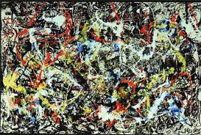
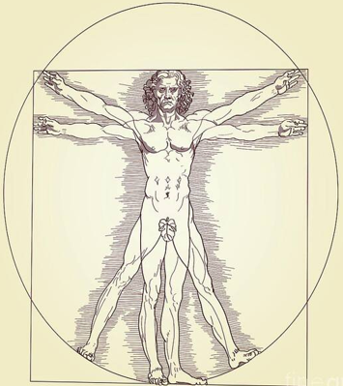
“platonic” standard
Generation
Creation
humanistic standard
Notes:
The Office and Court should be upfront that they apply two standards. I do not propose necessarily for one unified standard as I made clear in my article about affirmative action for human authors.

Slide 17
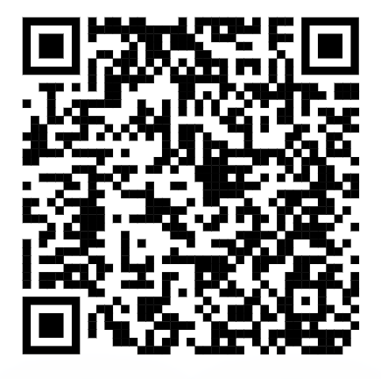
Manifesto:
1. gAI images are not original
2. Reintroduce formalities
3. Copyright register should become the training data and vice versa
4. Remuneration depending on use of the work
5. Signature styles should be protected
6. gAI content need to be labelled
7. Filter gAI output that mimics works in the training data
8. It is not a given that training LLM is fair use
Danny Friedmann, Copyright as Affirmative Action for Human Authors Until the Singularity, GRUR International, Volume 73, Issue 1, January 2024, Pages 1–2
Notes:
The Office and Court should be transparent in that they have two standards. In January 2024, I wrote the following manifesto. Until we can determine what was created and what was generated I proposed to give affirmative action to human authors and not protect any AI-generated image.

Slide 18
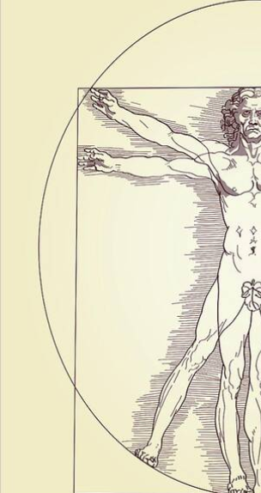

Notes:
I argue in my paper that we should apply a moratorium to the registration of AI-generated content, until we can distinguish between creation and generation. But we could solve this problem. So how to distinguish between human creation and AI-generation?

Slide 19


USCO must have access to database of
AI-service providers
Notes:
The U.S. Copyright Office (or any copyright office) should have access to the AI databases of generated products. Then they can compare the copyright applications with the generated products. This comparison can be done by AI, and we can think of a certain percentage as registrable under copyright.

Slide 20
AI-service providers must have access to database of USCO
Notes:
Vice versa, AI-service providers should have access to the works + metadata of these works in the database of the copyright office, so that they can train on these copyrighted works, and have the metadata so that they can remunerate the copyright holders.

Slide 21
Conclusion
The Office and Court should be upfront about double standard;
2. A dual standard is not necessarily bad (preferential treatment for human authors);
3. Moratorium for the protection of AI-generated images until we can distinguish between creation and generation;
4. Give access to the Office of the AI-service providers databases
5. Give access to the AI-service providers of the Office’s register to enrich their training data with metadata.
Notes:
My conclusions.

