Slide 1
Shall We Prompt Copyright over AI-generated Picture?
Dr. Tianxiang HE
Associate Professor
School of Law, City University of Hong Kong

Slide 2
“Humans will be replaced, if we are discussing the efficiency of information distribution. But, where the ‘information’ came from and what kind of information we want to distribute? That is the question.”
- Tianxiang He

Slide 3
  Last year…

Slide 4

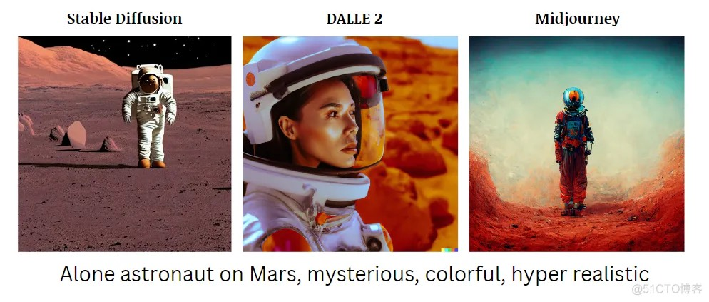
  Issues without a clear answer?
Issues related to generative AI: it challenged the traditional norms in copyright law about copyrightability, as it is intrinsically different from the traditional ways of creativity
This is a potential problem for both common law and civil law jurisdictions, as our laws didn’t anticipate such a change in terms of technology.

Slide 5
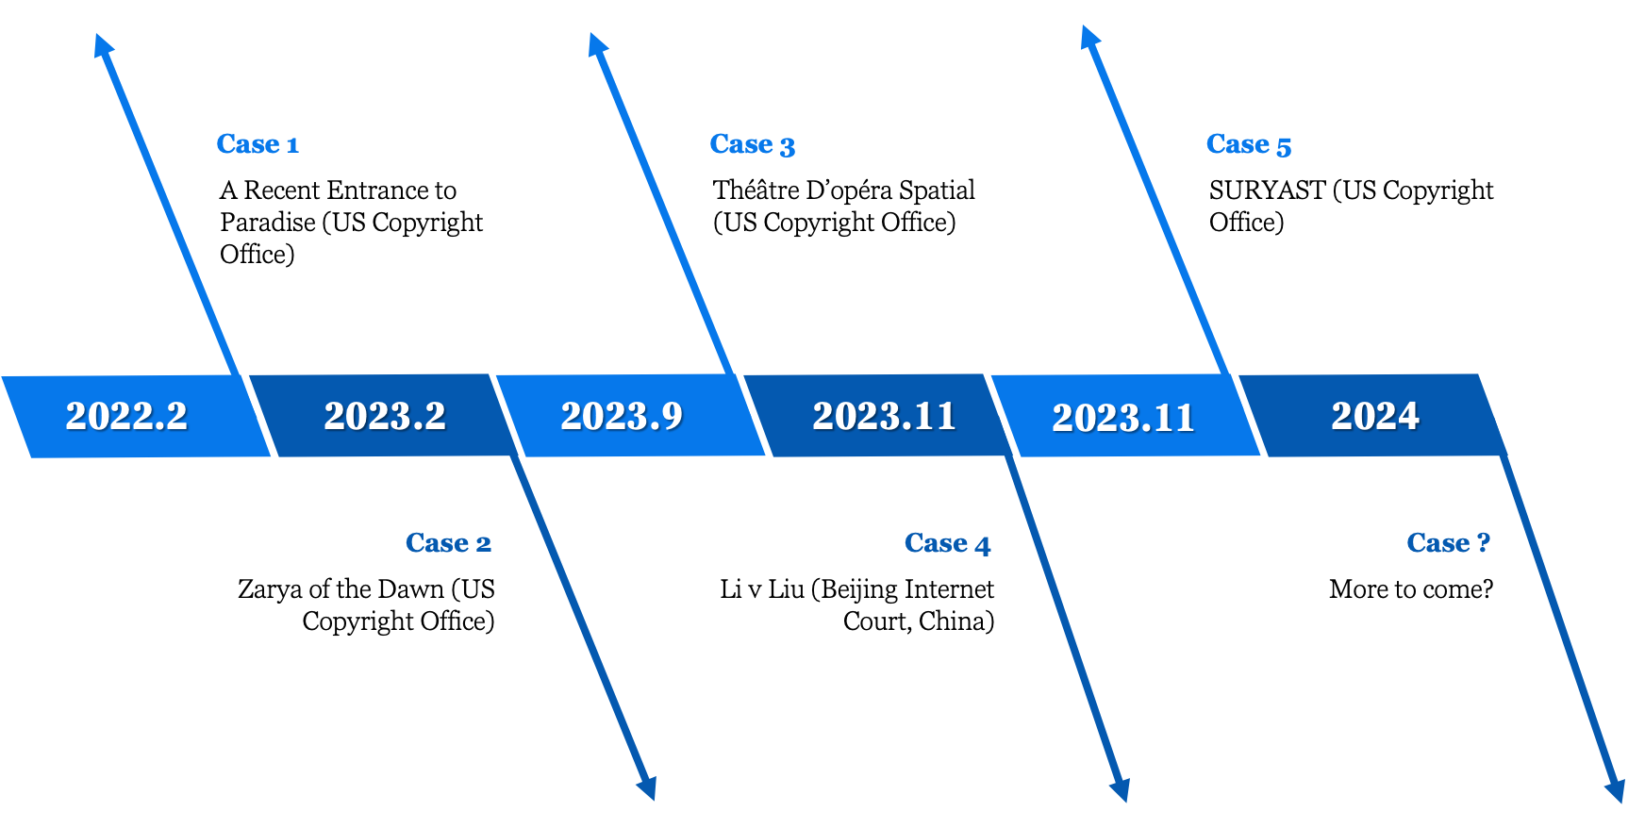
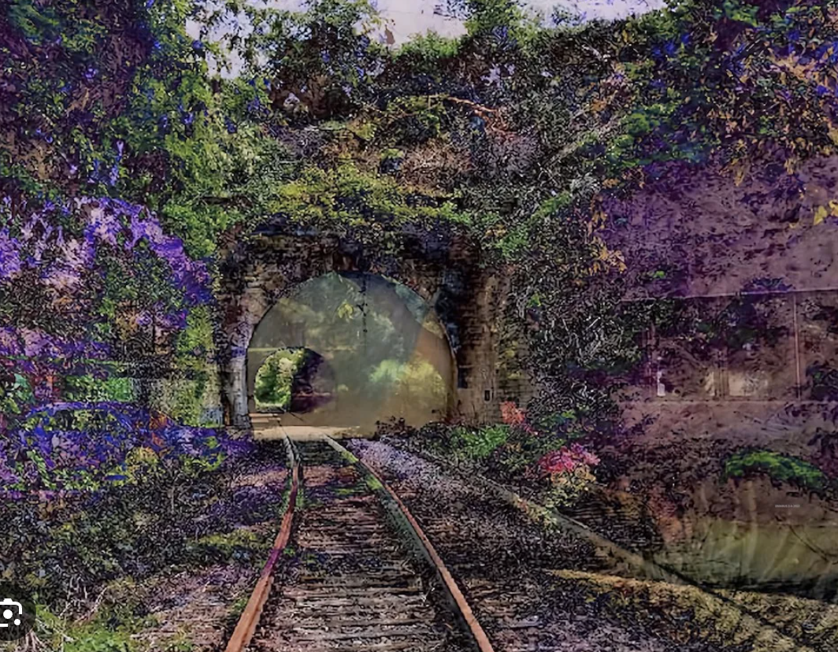
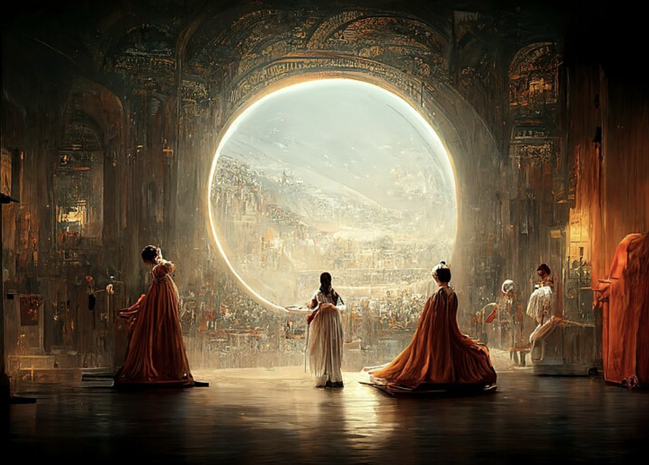
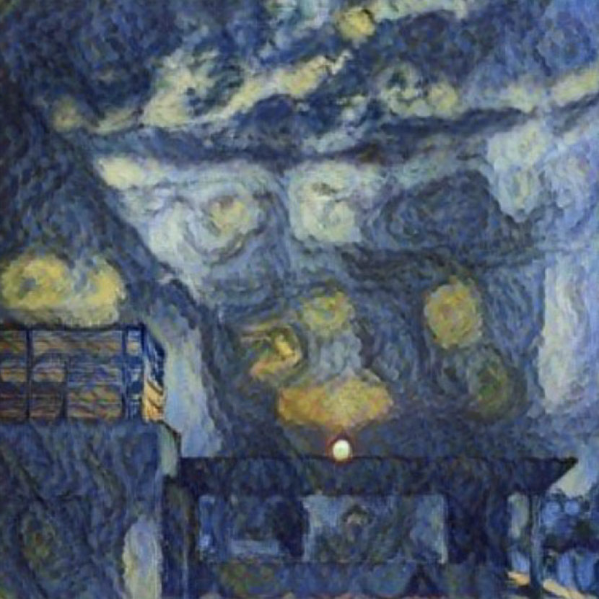
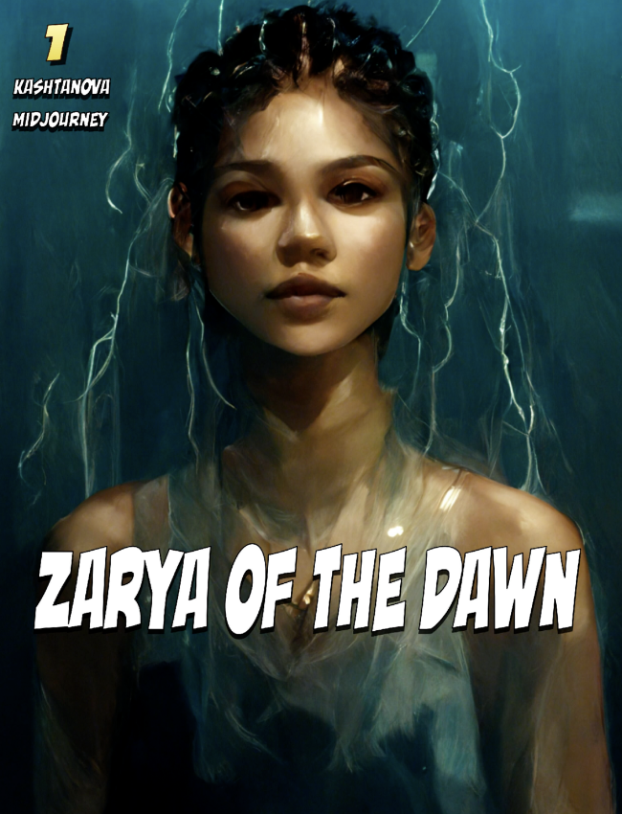
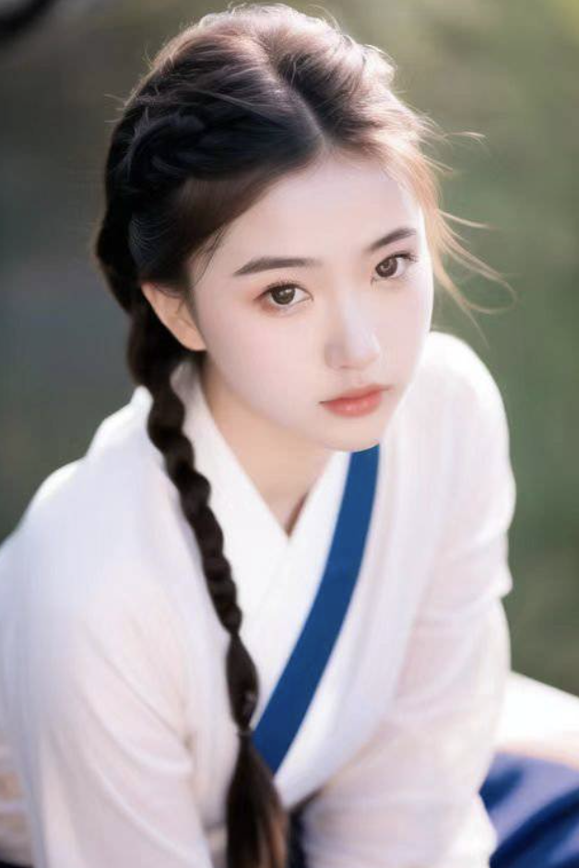
  Related Cases

Slide 6
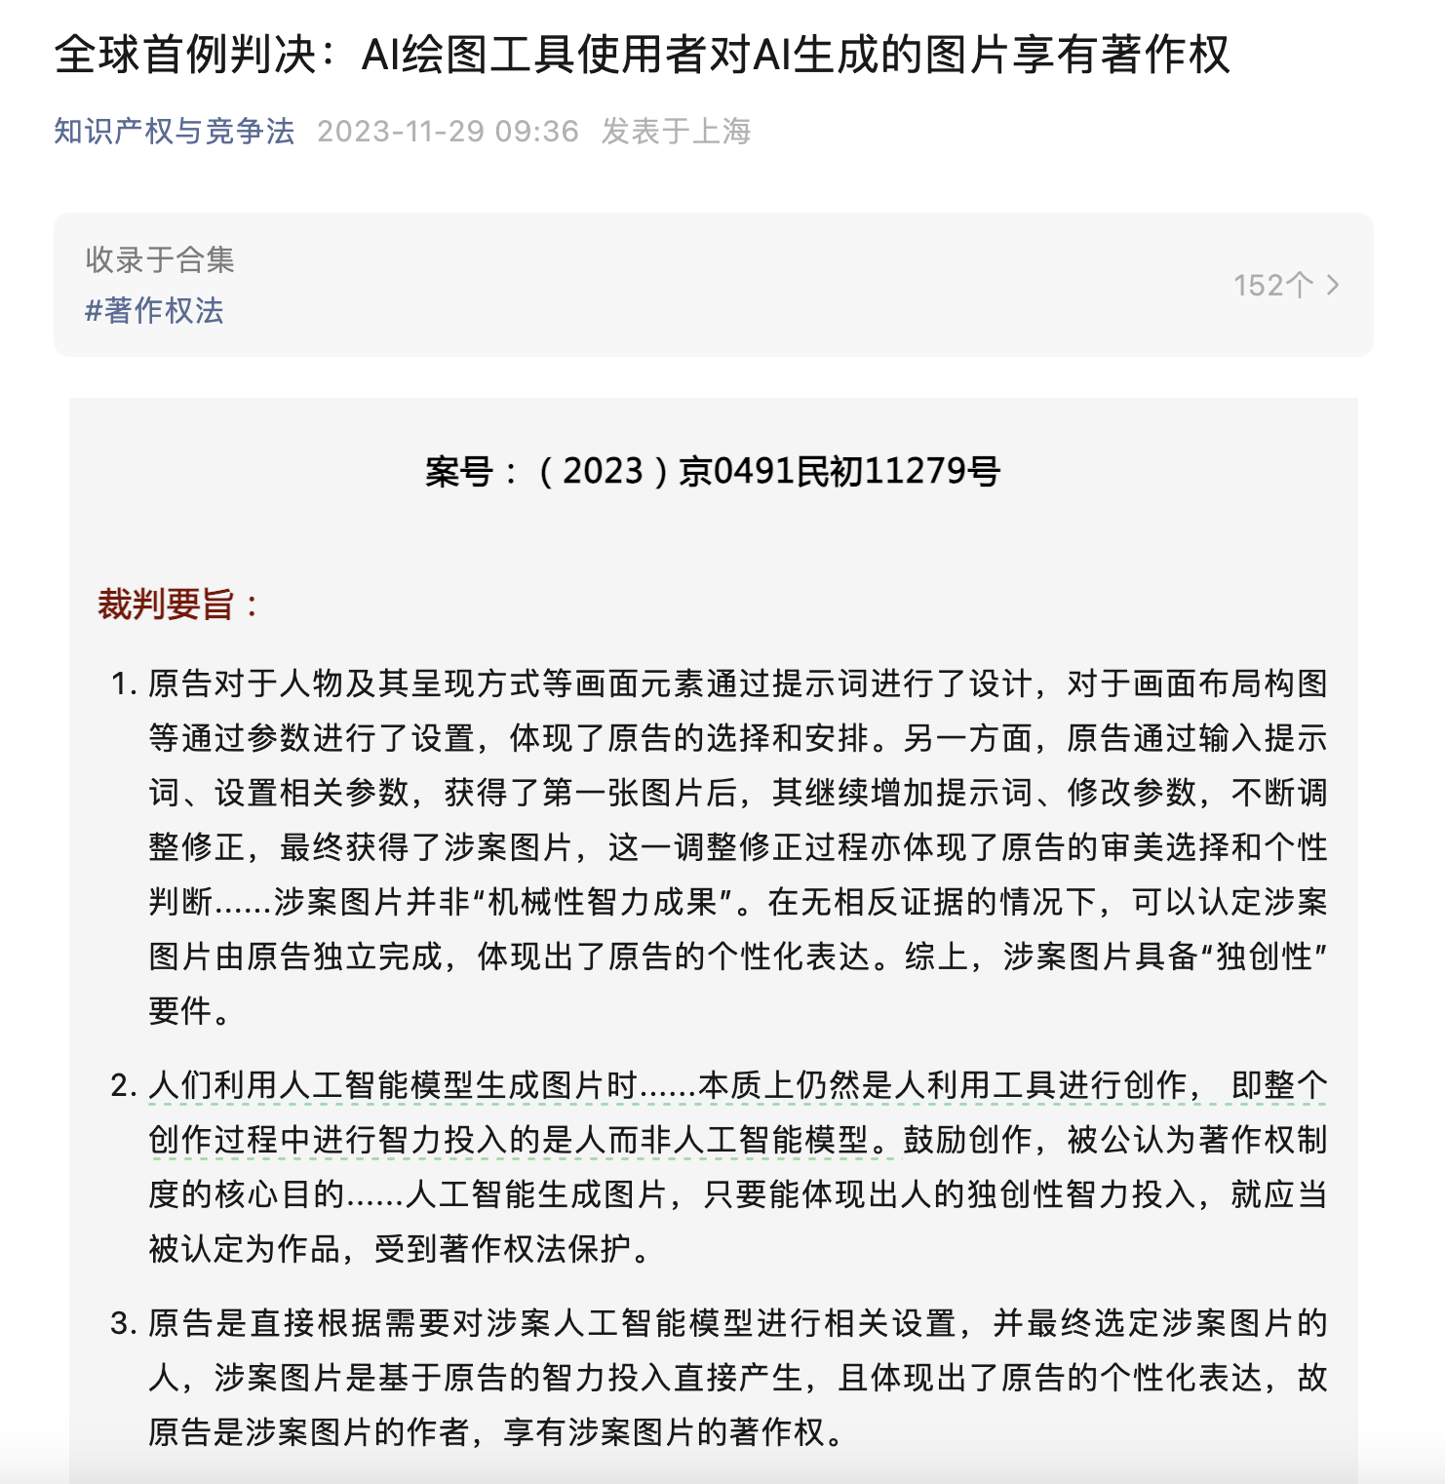
First case about copyrightability of AI-generated Pictures

Slide 7
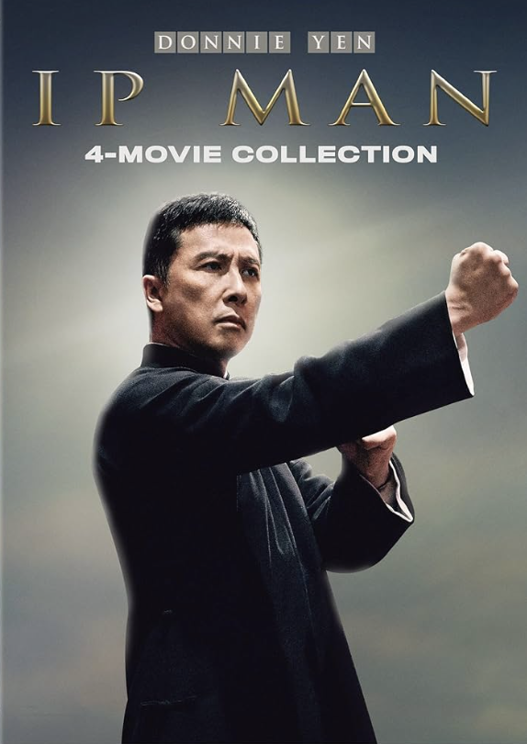
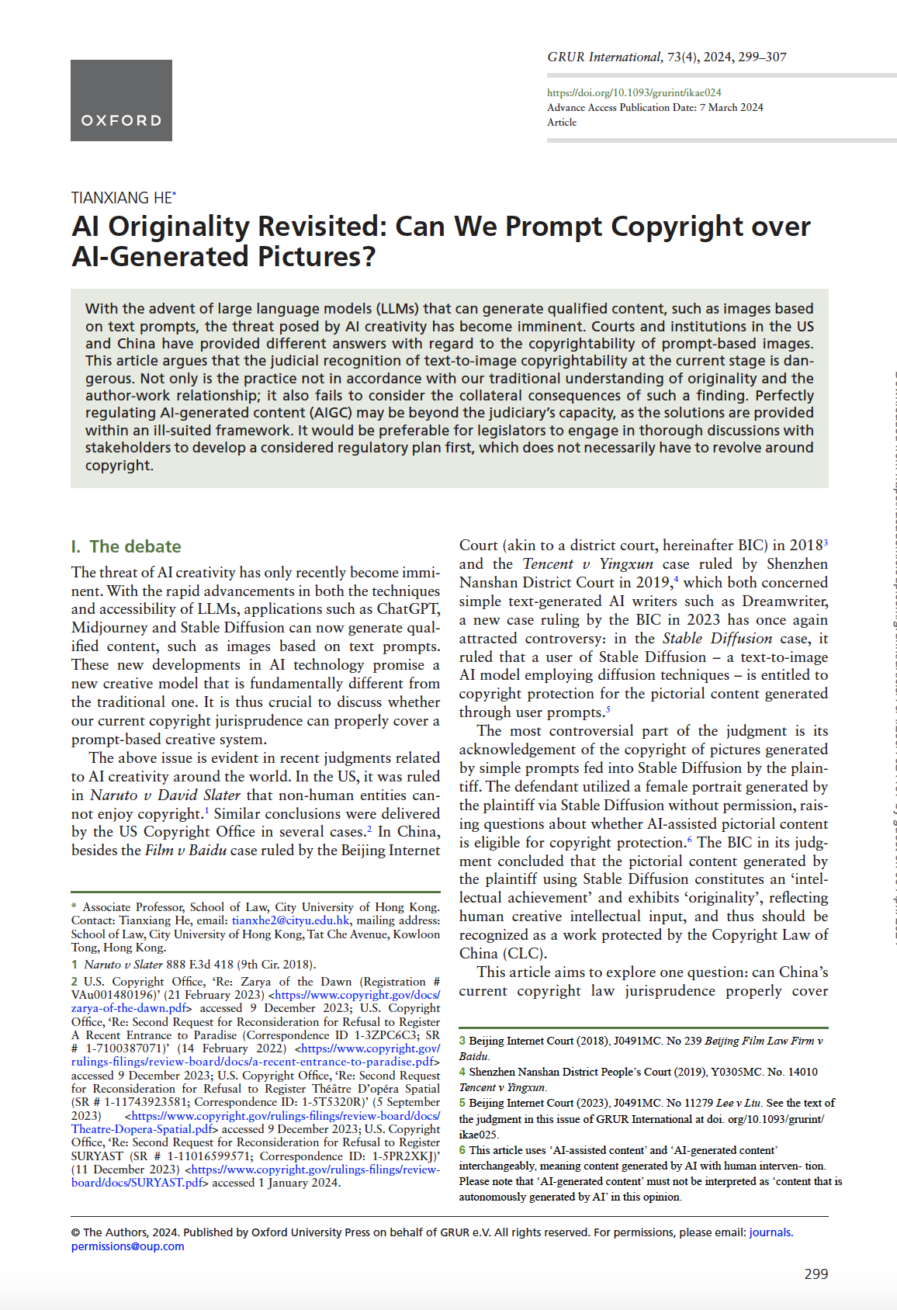
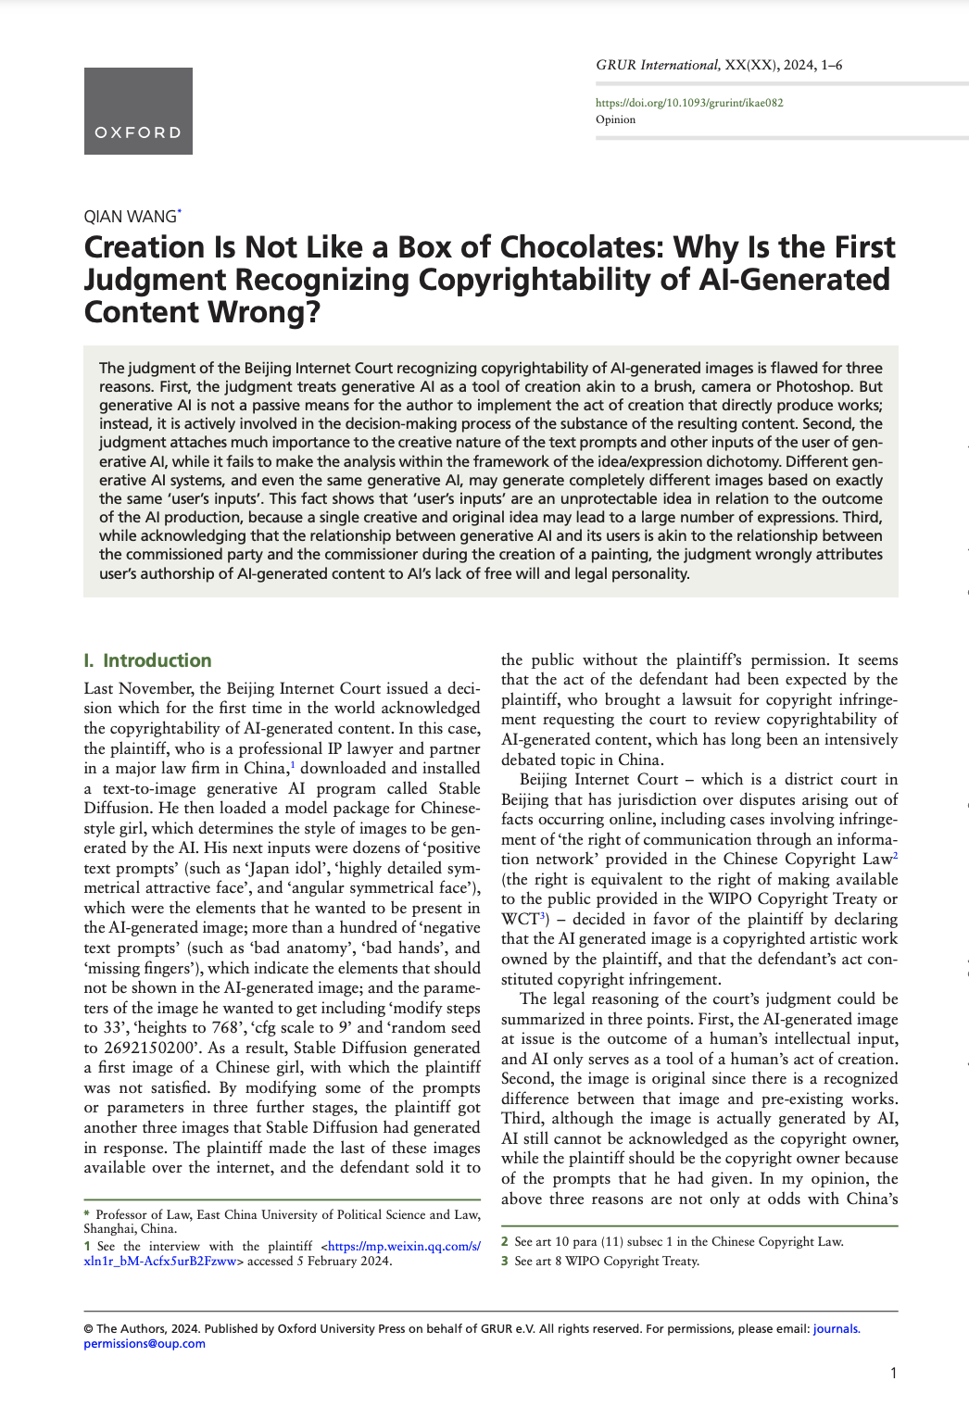

Slide 9
  Issues revealed
The case ruling is highly controversial:
  Theoretically speaking, it does not in accordance with the traditional understanding of our copyright norms.
  even if we can twist that fact by changing our mind set about human creativity, we still need to consider the impact of such an decision
  Macau, Hong Kong and mainland China need to have a unified attitude towards these emerging technologies

Slide 10
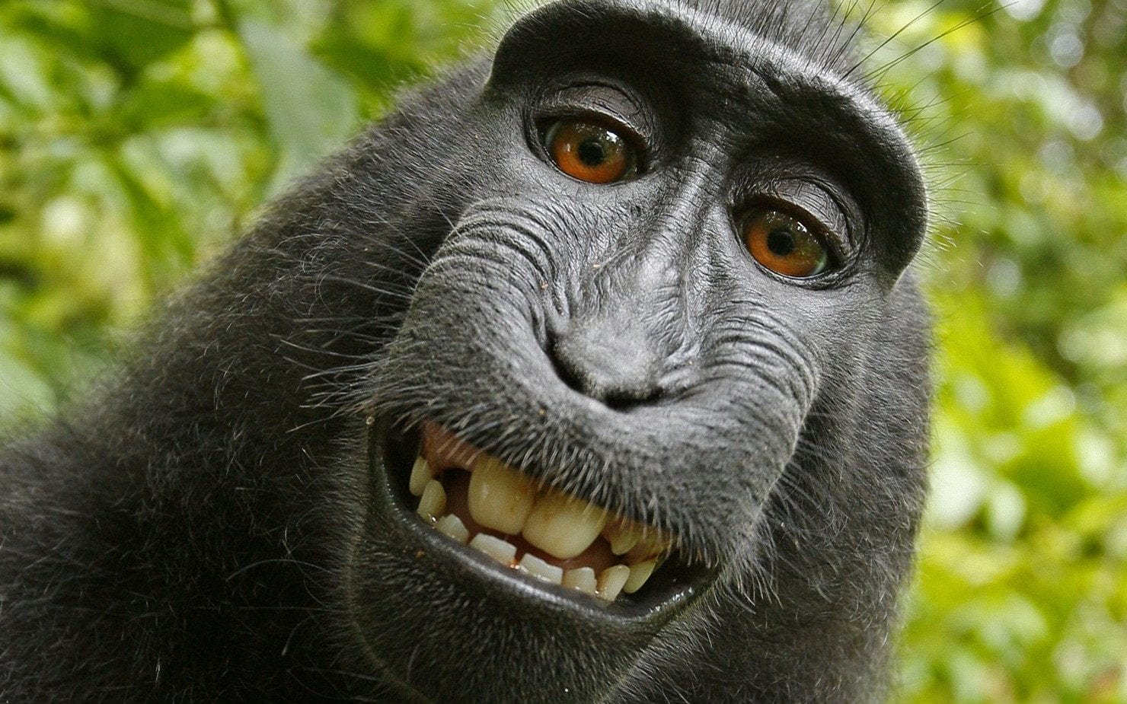
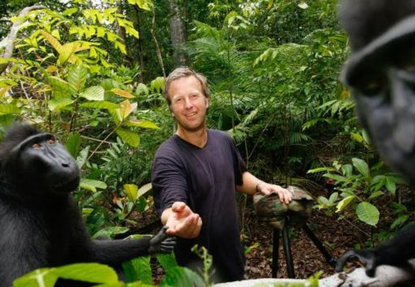
Naruto et al v. David Slater
Naruto et al v. David Slater
  Mr Slater travelled to Sulawesi, Indonesia, and spent a week taking pictures of macaques
  selfies taken by Celebes crested macaques using equipment belonging to the British nature photographer David Slater
  The popularity of the pictures triggered legal action after Mr Slater asked Wikipedia to take down one of the pictures which it had published without his permission
  Wikipedia refused, claiming the copyright belonged to the monkey. Then despite the US Copyright Office ruling that animals could not own copyright, an American charity, People for the Ethical Treatment of Animals (Peta), entered the fray. It sued Mr Slater in 2015, arguing that the copyright belonged to one of the macaques, Naruto.

Slide 11
“When an AI technology determines the expressive elements of its output, the generated material is not the product of human authorship. As a result, that material is not protected by copyright and must be disclaimed in a registration application.”
Copyright Registration Guidance: Works Containing Material Generated by Artificial Intelligence, 2023.3.16

Slide 12
Creative connection: human agency?
There has to be a creative connection: whether they are developers or operators, if the main content is generated by AI, as the US Copyright Office says, the humans involved haven't made substantial contributions.
  Exception: The work is mostly completed, and the author only polishes it with AI, or the author improves upon the AI-generated content, for their self-created parts of course there is copyright protection.
Writing prompts, this degree of labor input, may not even reach the “sweat of the brow” standard, it is too indirect. Most importantly, prompts are akin to thoughts/ideas, and the content generated often comes unexpectedly to the inputter.

Slide 13
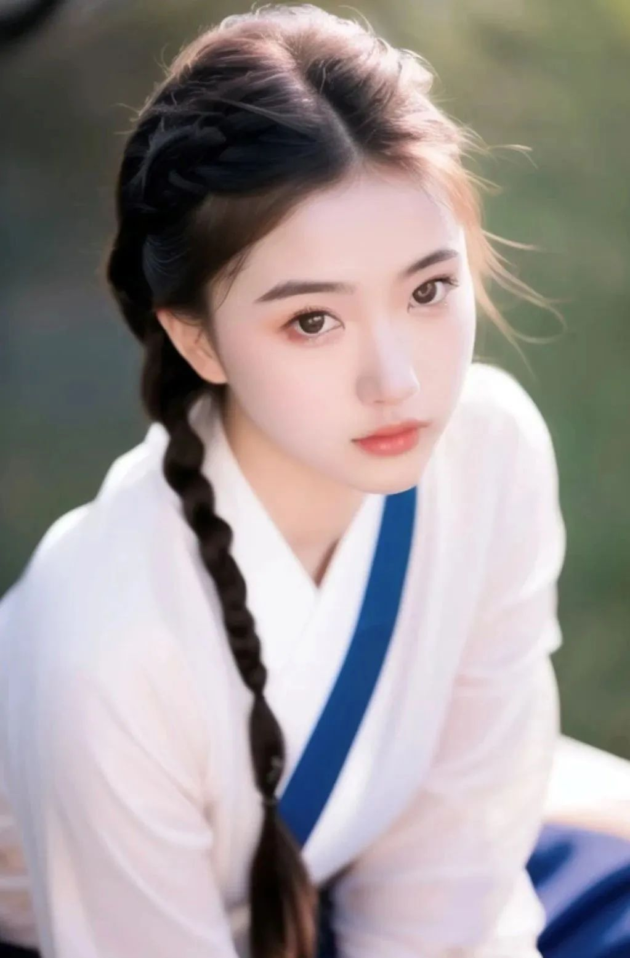
The StableDiffusion Case
On February 24, 2023, Plaintiff generated a few pictures using Stable Diffusion, a U.S.-based text-to-picture artificial intelligence service. He labelled one of such pictures as “Spring Breeze Brings Tenderness—AI generated picture” (春风送来了温柔) and posted it on a popular Chinese social media platform “Little Red Book” (小红书).
Defendant, a Chinese blogger, then published an article titled “Love in March, Among Peach Blossoms” (三月的爱情,在桃花里), using Plaintiff’s AI-generated picture “Spring Breeze Brings Tenderness” as an illustration in her article, but removing Plaintiff’s user ID and the watermark of Little Red Book from the picture.
Plaintiff soon sued Defendant for copyright infringement, including violating his right of authorship and the right of dissemination via the internet.

Slide 14
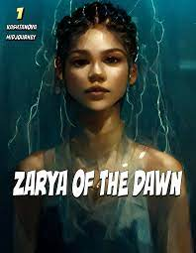
Ruling
With regard to the criteria of “intellectual creations”, the court held that a (copyrightable) work should reflect the intellectual input/contributions of human beings.
For the ‘intellectual achievement’ part, the BIC observed that from the plaintiff's conceptualization stage to the final selection of the image, the process involved significant intellectual input. This encompasses designing the female character’s presentation, selecting, and arranging prompt words, setting parameters, and choosing the final image that meets the expectations. The image thus mirrors the plaintiff’s intellectual investment and qualifies as an ‘intellectual achievement.’
However, the US Copyright Office indicated in the Zarya of the Dawn case that ‘[b]ecause of the significant distance between what a user may direct Midjourney to create and the visual material Midjourney actually produces, Midjourney users lack sufficient control over generated images to be treated as the “master mind” behind them.’

Slide 15
Ruling
With regard to the criteria of “originality”, the Beijing court held that a copyrightable work should be independently created by its author and reflect the author’s personalized expressions.
The BIC first recognized that ‘the plaintiff did not personally draw the specific lines, nor did they instruct the Stable Diffusion model with 100% clarity on how to draw these specific lines and colours’ and ‘it can be said that the lines and colours that constitute the involved picture were essentially “drawn” by the Stable Diffusion model,’ which is ‘significantly different from the traditional method of using paintbrushes or graphic design software for drawing’
but it nevertheless provided that ‘after obtaining the first picture by inputting prompt words and setting relevant parameters, the plaintiff continued to add prompt words and modify parameters, constantly adjusting and correcting until they obtained the picture in question. This process of adjustment and correction also reflects the plaintiff’s aesthetic choices and personal judgments.’

Slide 16
‘when an AI technology receives solely a prompt from a human and produces complex written, visual, or musical works in response, the “traditional elements of authorship” are determined and executed by the technology—not the human user.’
Copyright Registration Guidance: Works Containing Material Generated by Artificial Intelligence, 2023.3.16

Slide 17
The BIC used two examples to support its ruling, with the first being the camera. The second is commissioned work
The underlying argument is that ‘the development of technology is a process of gradually outsourcing human tasks to machines.’

Slide 18
Camera v AI: creative tools?
Camera is not a good example to argue that reduced labour due to technological advancement guarantees copyright protection: if the labour is not enough, it will not be protected.
There is a fundamental difference between selecting materials and elements versus selecting final outcomes

Slide 19
Commissioned work?
in the Zarya of the Dawn case, the US Copyright Office opined that ‘[i]f Ms. Kashtanova had commissioned a visual artist to produce an image’ and ‘the author would be the visual artist who received those instructions and determined how best to express them.’
This logic holds only if the commissioned party (the assignee) is a human author capable of holding copyright. If there is no copyright protection in the first place, then there is nothing to share if we cannot recognize the AI application’s ‘creativity’.
Just like the example provided by the US Copyright Office, ‘if Ms. Kashtanova were to enter those terms into an image search engine, she could not claim the images returned in response to her search were “authored” by her, no matter how similar they were to her artistic vision.’

Slide 20
The aim of copyright: impact revisited?
It is true that as technology advances and tools become more intelligent, the need for human input decreases.
The BIC: “by granting user copyright over AI-assisted content, we can encourage creativity and further promote the development of AI technology.”
However, it is not proper for courts to make such a conclusion without a thorough discussion about the potential impacts.

Slide 21
Can we recognize it?
Edward Lee: such an approach (rigid interpretation of authorship and the creative process, which he describes as a linear progression from conception to production, without considering iterations or interactions between these stages) restricts us to the current state of affairs and overlooks the evolution of human creativity.
His critique, originally targeting the US Copyright Office’s potential misinterpretation of the copyright clause, which ‘conflicts with the liberal construction of the “Writings” of “Authors” in the Copyright Clause and ignores its overriding objective to promote progress in the United States by incentivizing creators to create and disseminate their works to the public,’ resonates with similar concerns about the aims of the CLC.
(Prompting Progress: Authorship in the Age of AI, 2024)

Slide 22
The transition of creative patterns
From a traditional creative mode of generating content through a relatively long creation time period, by determining a theme and making artistic choices at different times, to a new creative mode of determining a theme, generating a large amount of content with the help of AI in a very short time period, and then making selective choices.
However, the real issue lies in the low threshold the Stable Diffusion case has set, the impact of this shift, and whether the associated costs, both cultural and legal, are acceptable and sustainable.

Slide 23
The impact of speed: How fast should it be?
The potential impact of generative AI on the creative market is more about speed than quality.
  Printing machine, digital technology, internet, then to generative AI
  Unlike these predecessors that focus on the copy tools side, generative AI is transforming the side of the creative tool, reducing the intellectual and labour investment required for tasks like painting, writing, and coding.
  This democratization of creative tools and knowledge, while stimulating overall creativity, also lowers the barrier to acquiring a broad range of skills that traditionally required extensive training.
  It is not new, but generative AIs are more radical in for two reasons: freeing us from/take away the chance to receive training and controlling our speeches (inner); provides almost everyone the ability to produce outcomes of acceptable quality quickly for almost all creative industries (outer) (Matthew Sag 2019).

Slide 24
The result of no copyright protection?
People will still use generative AI to generate contents, the threats I mentioned will continue as revolution will go on.
But without copyright protection, the desirability and ability to litigate subsequent uses would be limited, potentially easing the burden on courts and attenuating the abruptness of these transformations, ensuring thoughtful consideration in our legislative approach to minimize societal disruption.
Tragedy of the commons for protected expressions?

Slide 25
Same terminology, different understanding
The aim of copyright, as explained above, is never to accommodate or even recognize every form of artistic expression, no matter if it is old or new. That is the realm of philosophers and artists, not the copyright law.
If we agree that the delicate balance between the protection of copyright owners and the interests of the public should be maintained, the interpretation of the terms ‘author’ and ‘work’ as provided by copyright law should be in line more with its utilitarian purpose, that is to provide stable rules ensuring the sustainability of the creative business.
Thus, theoretically justifiable copyright claims must be weighed against their societal impact: if the claims are deemed to be de minimis, the court can simply dismiss them; if accepting the claims will be destructive to the market, then courts should exercise restraint.

Slide 26
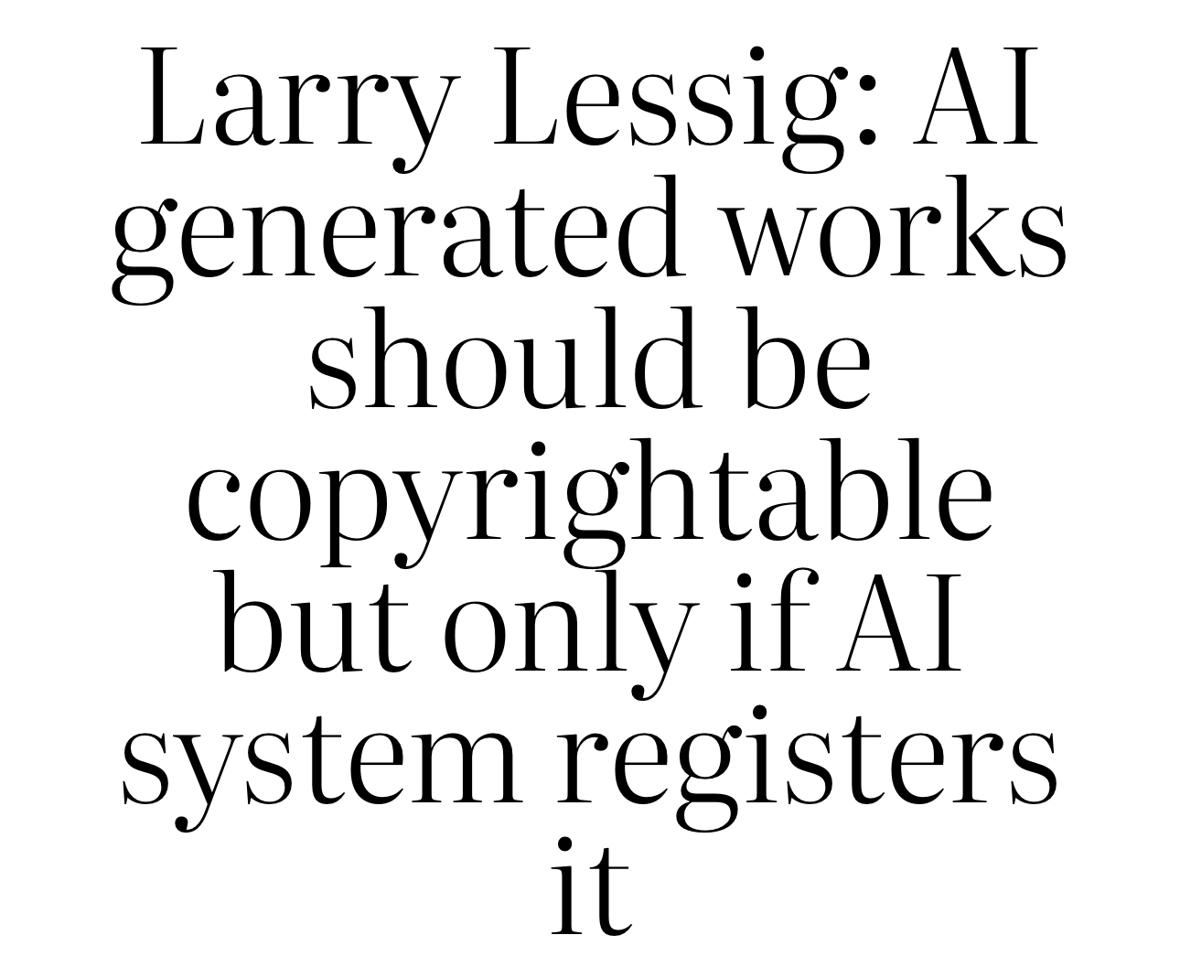
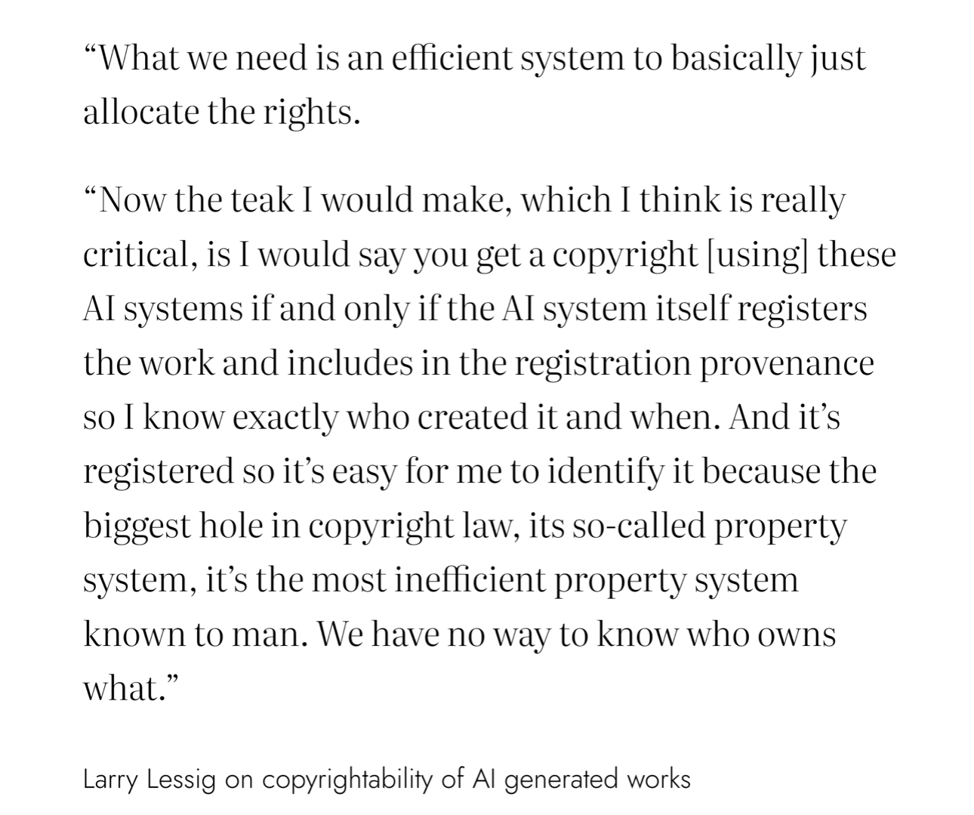

Slide 27
The need to distinguish
distinguish between human works and AI-generated content, thereby significantly reducing the huge cost brought about by the romantic ideas in copyright history.
  Digital signatures: traceable, hard to erase, easy to recognize by technology (not watermarks that can be easily removed)
The BIC opined that ‘it should be noted that although in this case, the Court recognized the plaintiff as the author that enjoys copyright, according to the principle of good faith and the need to protect the public’s right to know, the plaintiff should clearly indicate the use of AI technology or models. In this case, the plaintiff marked it as “AI Illustration,” which is sufficient to inform the public that the content was generated by AI technology by the plaintiff. The court affirms this approach.’

Slide 28
Possible Solution?
Danny Friedmann:
dual standard: one for human-created works; and a different one for AI-assisted products. Therefore, it is important that artists disclose the part of the work generated by AI. But equally significant is that providers of AI-services make a database of generated AI-products available to the Office, so that it will be able to compare the applications for copyright registration with those products generated by AI, to see whether the human intervention meets the threshold and originality. Until this is possible, there should be a moratorium on the protection of AI-generated products via copyright law or a sui generis right.
(Creation and Generation Copyright Standards, 2024)

Slide 29
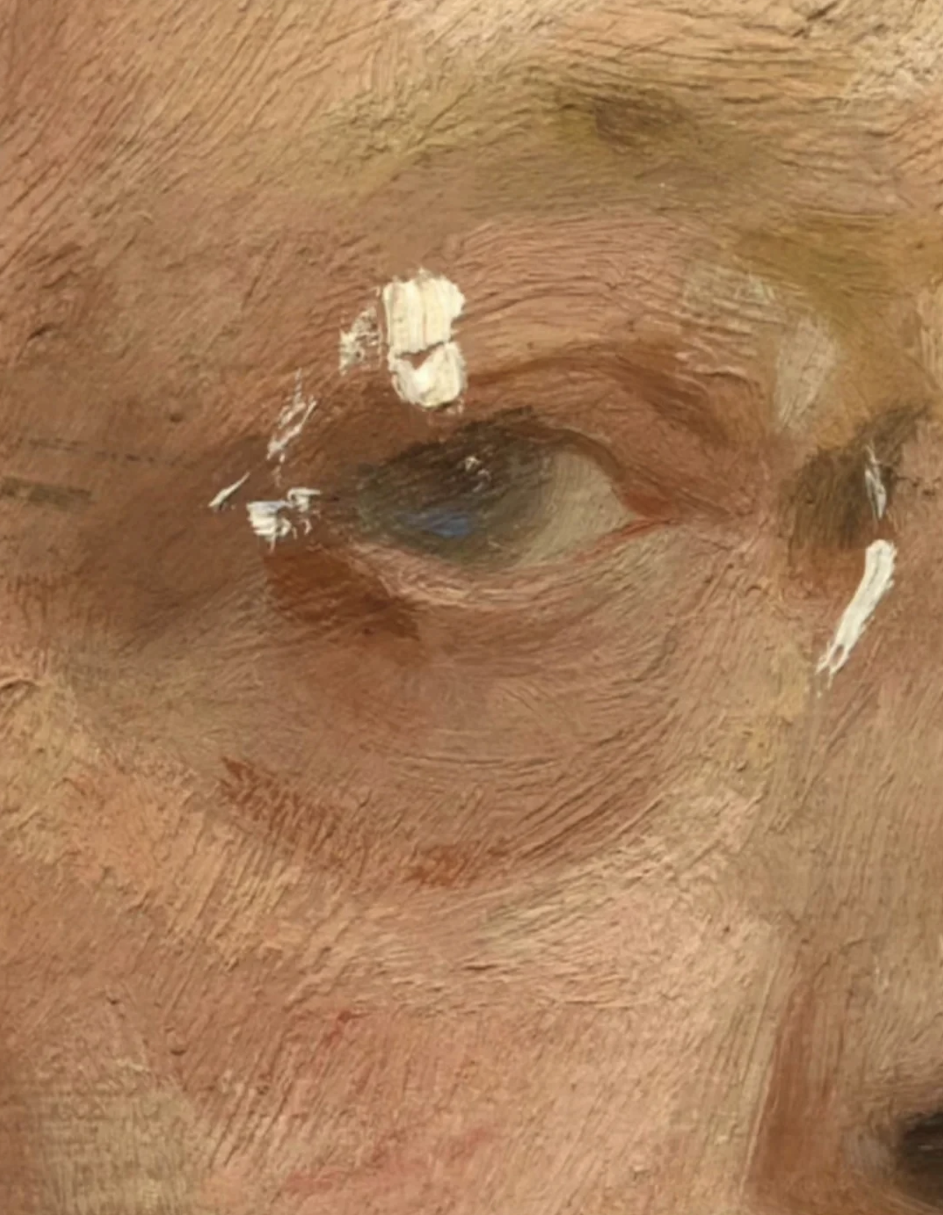

Slide 30
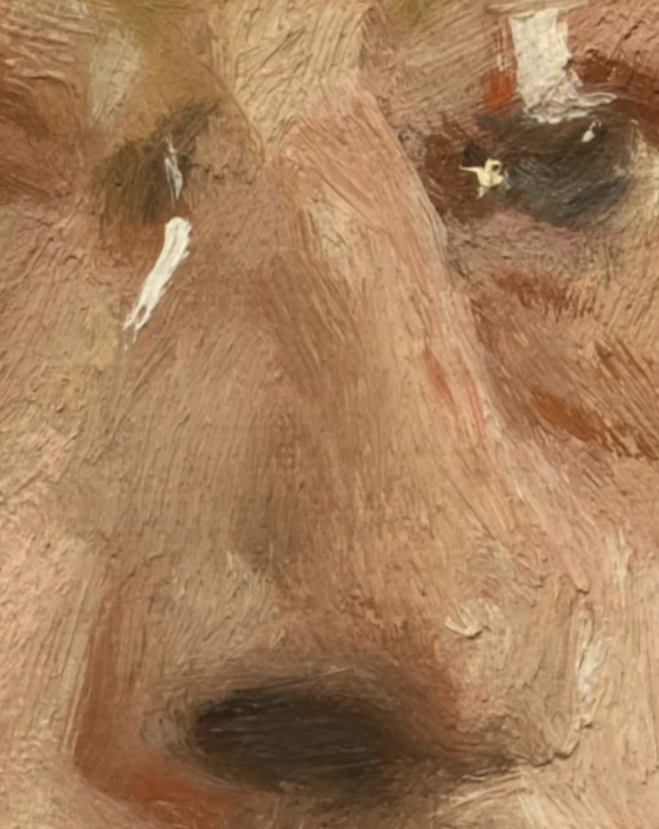

Slide 31
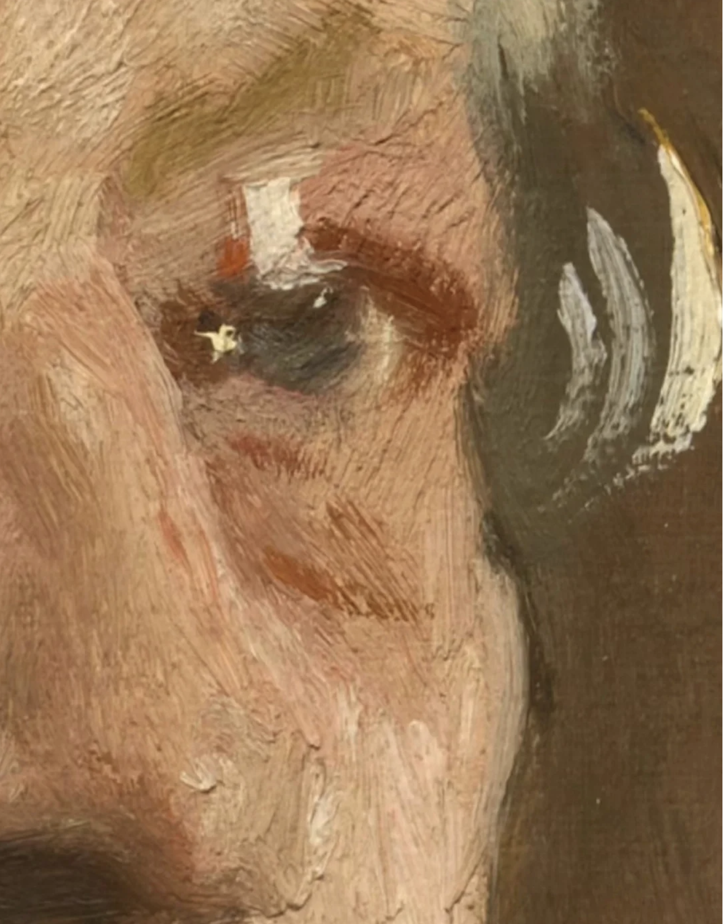

Slide 32
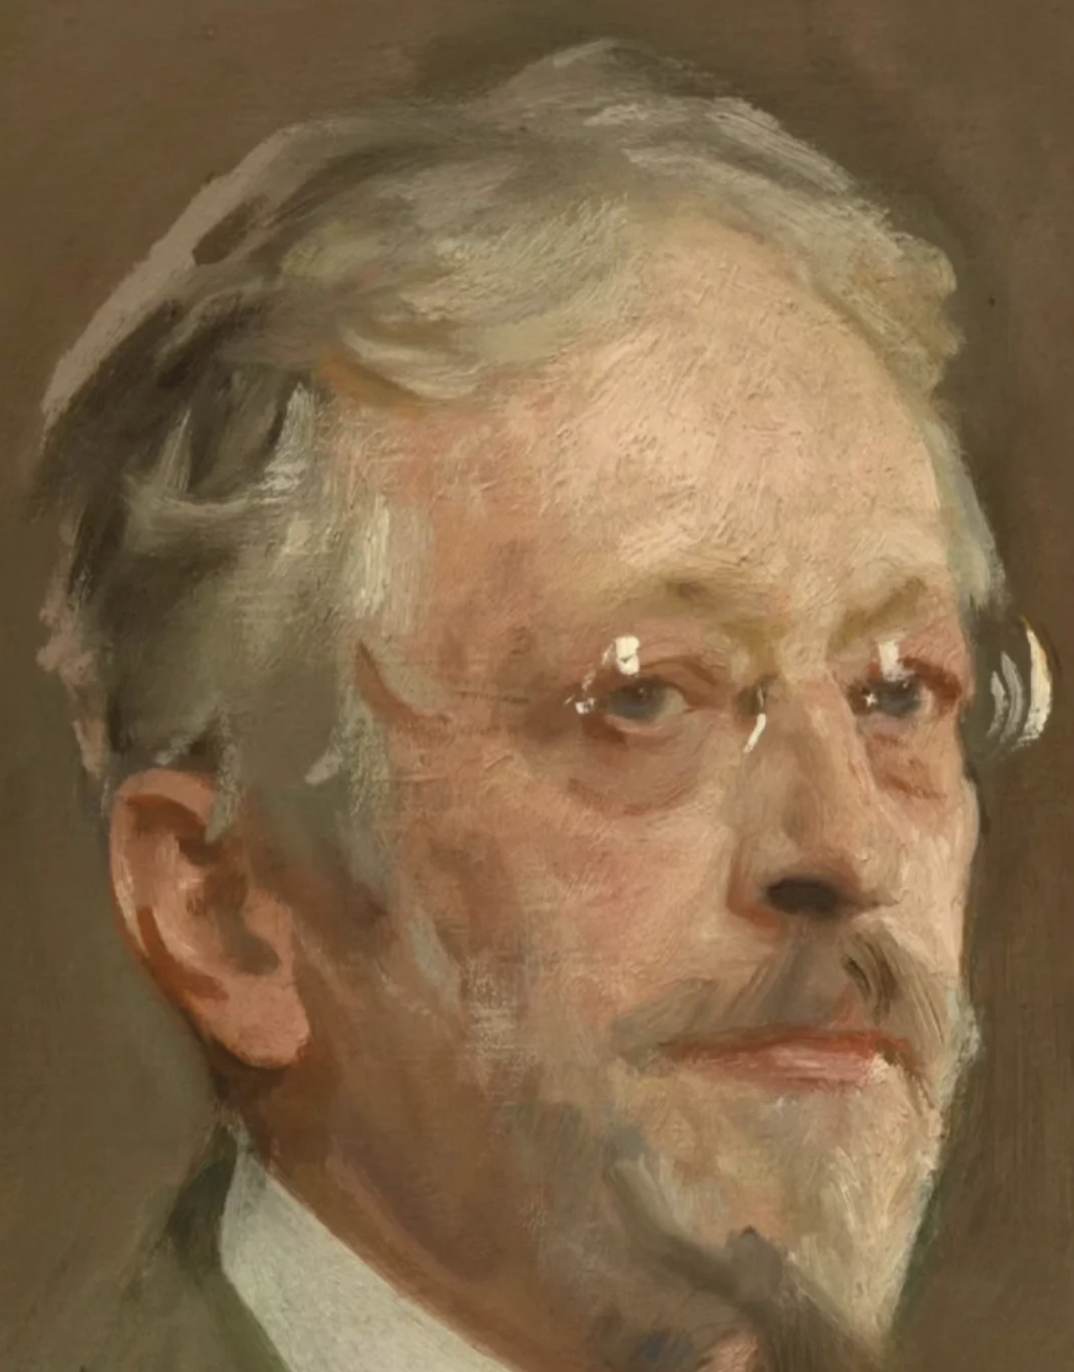

Slide 33
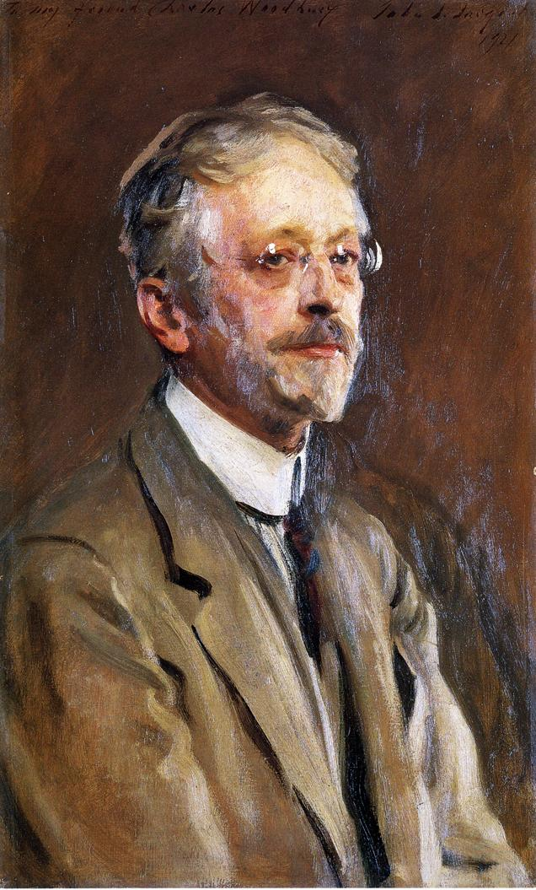
John Singer Sargent, (1856－1925)
Charles Woodbury by John Singer Sargent (1921)

Slide 34
“The quest for facts and truth should not lead societies to experience life through a filter whose contours are undisclosed and untestable. The spontaneous experience of reality, in all its contradiction and complexity, is an important aspect of the human condition - even when it leads to inefficiency or error.“
The Age of AI: And Our Human Future (Henry Kissinger, Eric Schmidt, and Daniel Huttenlocher 2021) 219

Slide 35
Thanks!

